Slide 1
Course : T7043 – IT Services
Period : February 2018
Problem & Change Management
Session 05
D5664 – Dr. Eng. Antoni Wibowo

Slide 2
Problem Management
Problem Description
Severity
Time Opened
Group Assigned
Contact Information
SCIM
Time Closed
Change Integration
Duration for resolution
Resolution

Slide 3
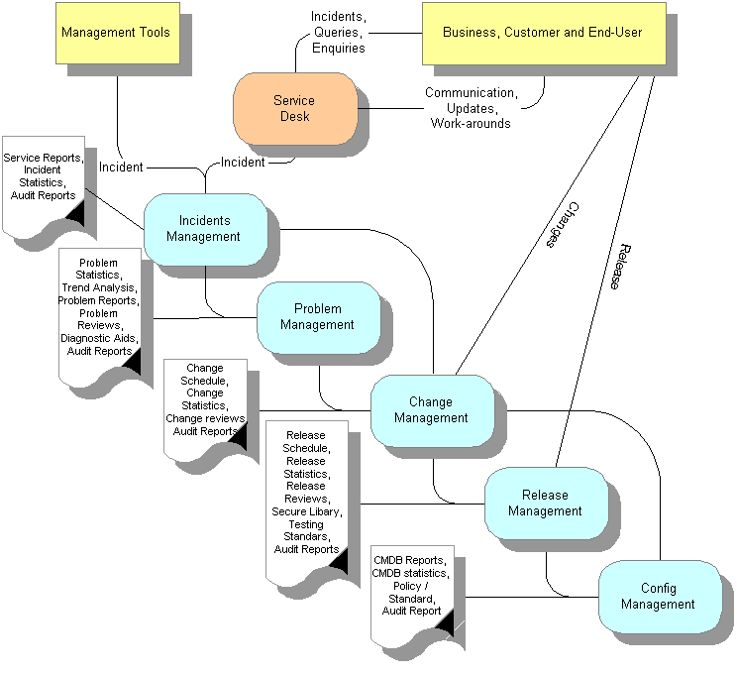
Change Management
Bina Nusantara

Slide 4
Problem Management
Incident/Problem review meetings
Root cause analysis review meetings
Generate and post operational and management reports
Provide ad hoc Incident and Problem reports
Problem analysis and trend reporting, which lead to identifying common problems and recommendation of improvements to prevent future Incidents and Problems
Maintain a current list of infrastructure IT elements

Slide 5
Problem Management
Identify and report Problems that impact customer’s business. (assign business criticality by element, or a step from BSM)
Identify and escalate duplicate and reoccurring Problems for expedited resolution (provide preventative or automated actions)
Manage Problems to resolution
Review and validate Severity levels set by customer or IT Infrastructure support staff
Identify Problem trends, accuracy of information, and completeness of problem tickets (also part of ITIL)
Identify responsibilities between service providers and customer within procedures

Slide 6
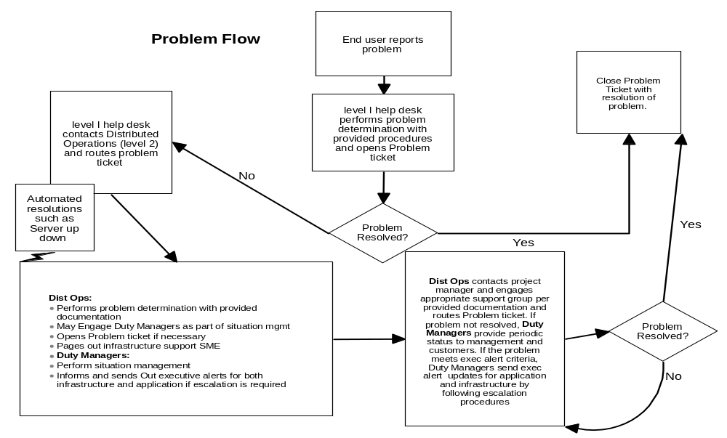
Problem Management
Bina Nusantara

Slide 7
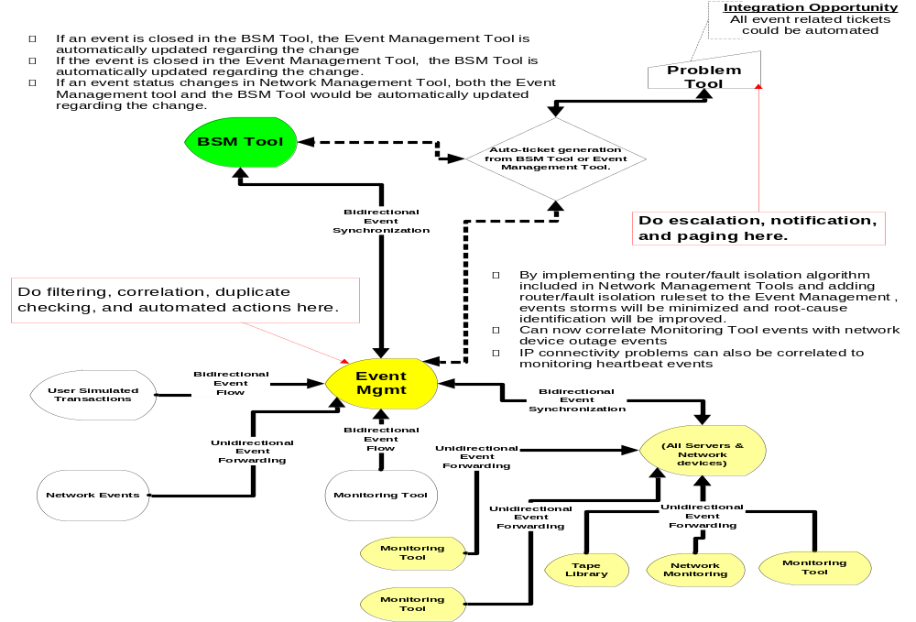
Problem Management
Bina Nusantara

Slide 8
Possible Infrastructure Service Interconnections with Problem Management
include:
Configuration Management
Event Management
Availability Management
Performance and Capacity Management
Operations Management
Security Management
Network Management
Bina Nusantara

Slide 9
Possible Relationship Service Interconnections with Problem Management
include:
Reporting Management
Change Management
Knowledge Management
Notification Management
SLA Management
Bina Nusantara

Slide 10
Problem Management tool sampling
  BMC’s Remedy
  HP’s Peregrine
  Managed Objects
  IBM’s Enterprise Systems Manager
  IBM MRO’s Maximo (TSD)
  PeopleSoft’s Vantive

Slide 11
Change Management

Slide 12
Change Management
Change Management is responsible for controlling and managing changes to the IT environment, from inception through implementation and in some cases at the operational stage.
A change is anything which alters the status of an IT element, or in ITIL, a configuration item (CI).
Change Management goal is to ensure that standardized methods and procedures are used for efficient handling of all changes, in order to minimize the impact of change-related incidents.
Bina Nusantara

Slide 13
Change Management workflow options include:
Recursive
Concurrent and multi branching
Dependencies

Slide 14
Benefits of Change Management
Minimize the risk of business continuity to IT services
Reduce number of incidents caused by changes to none
Ensure accurate cost assessment of proposed changes before approval
Allow technical changes at the rate required for business need
Provide connection between business and the supporting IT Infrastructure
Provide innovation opportunities for the business with a supporting stable IT service
Bina Nusantara

Slide 15
Change Management
Own and administer the change management process documents
Coordinate change requirements
Audit change records for process compliance including risk assessment
Coordinate change process and tool requirements including customer specific elements
Administer as required user access to the organizational standard change management tool
Facilitate Change Management meeting and follow-ups. Review and seek customers account approvals for requested changes via the weekly change meeting
Analyze Change management standardized operational reporting deliverables
Document action plans to resolve identified trends and improve Change Service Levels
Provide ongoing Change process & tool training
Maintain Change Document Of Understanding
Bina Nusantara

Slide 16
Change Management
Changes applications, infrastructure or both.
Establishing change windows during which changes may be performed without negatively affecting projected availability or SLA commitments
Enforcement of standard methods and procedures from request for change through post implementation review
Establishing regular meetings and communication schedules to evaluate proposed changes and schedules
Control and management of the implementation of those changes that are subsequently approved
Maintenance of open channels of communications to promote smooth transition when changes take place
Increased visibility and communication of changes to both business and support staff.
Bina Nusantara

Slide 17
Changes
Changes are classified by the following types:
Hardware Installations, removals, relocations or modification of information technology processors and peripherals
Software Modifications to the system operating code, access methods
Applications
Network: Changes specifically related to the installation or modifications of network components
Bina Nusantara

Slide 18
Changes
Environment: Changes that involve the information technology facilities.
Infrastructure: Changes that involve management infrastructure components
Operations: Changes to operational procedures that may affect systems availability or accessibility or changes that may impact the normal, operational delivery of a service.
Information : Changes that may be registered in order to ensure the availability of specific services at special times or changes performed by external parties
(De)Activation: all changes for activation or de-activation of service.
Bina Nusantara

Slide 19
Classification of changes based on severity include:
  Emergency Changes
  Exception Changes
  Normal Changes
Bina Nusantara

Slide 20
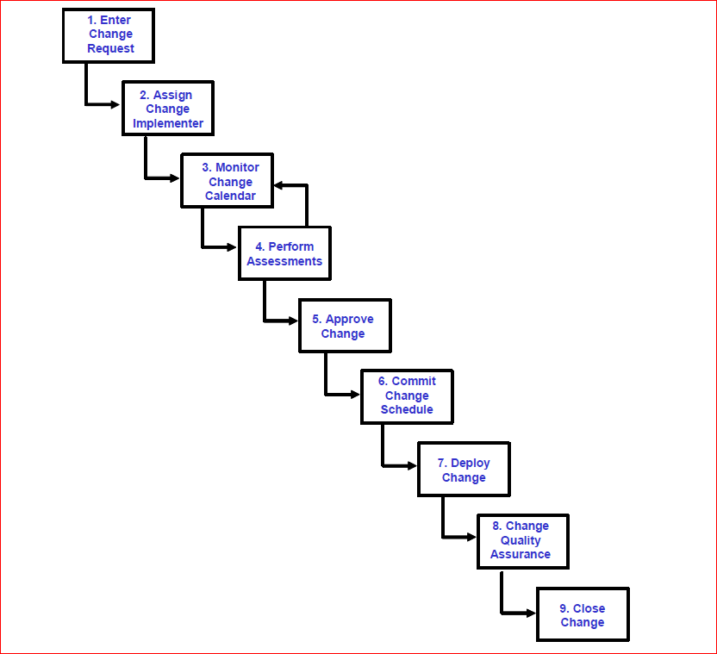
Change Request Flows
High Level Process Flow
Bina Nusantara

Slide 21
Change management
Process Role | Executing Competency
Change Activator / Installer | Platform system engineer architect
Change Approver | Change team; Platform system engineer; service manager
Change Assessor | Change team; Platform system engineer; service manager
Change Assignee | Systems Management Expert
Change Controller | Change team
Change Coordinator | Platform system engineer (acting service manager); service manager
Change Group Leader | Platform system engineer (team/change leader)
Change Requester | Platform system engineer (acting service manager); service manager
Requester / Closer | Customer (CSC); Platform system engineer; Service Manager
Change Scheduler | Change Team, Platform system engineer, Service Manager
Change Tester | Platform system engineer
Bina Nusantara

Slide 22
Change management considerations
Lead Times
Escalation Policy
Notification Policy
Endorsement Policy
Change Meetings
Change Control
Bina Nusantara

Slide 23
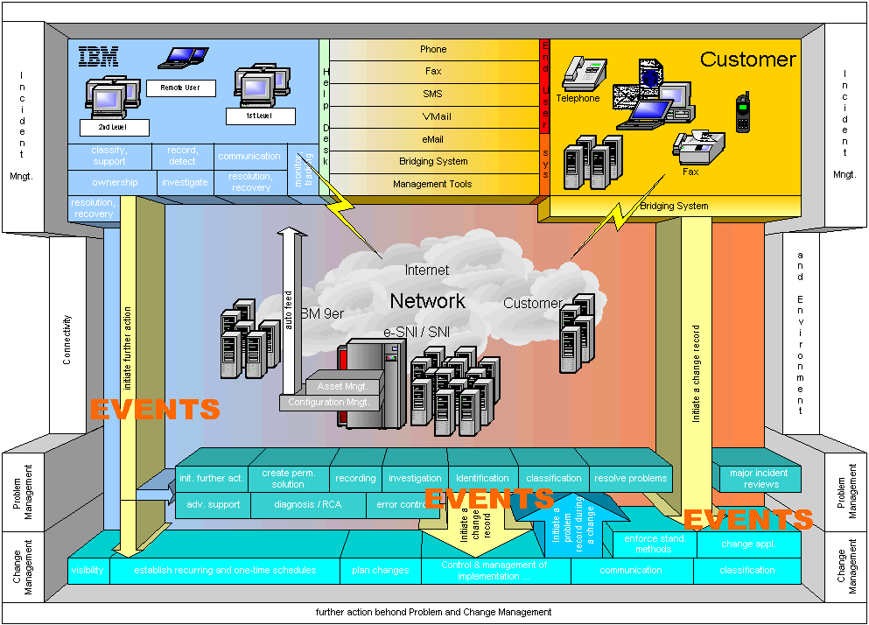
Block diagram Management
Bina Nusantara

Slide 24
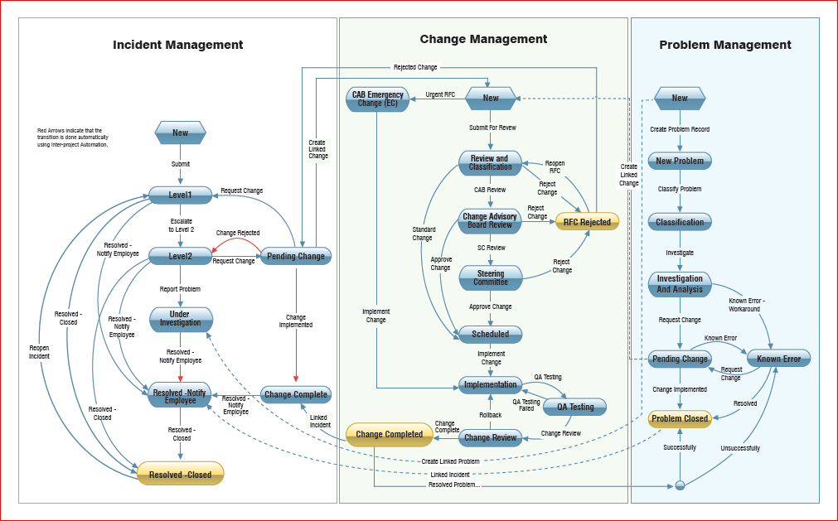
Workflow
Bina Nusantara

Slide 25
Change Controller
Monitoring Change Categories and Service Risks
Ensuring that all Information Technology customer and Company interests are protected
Building and maintaining the Consolidated Change Schedule:
Integrating new changes into the existing change schedule
Identifying conflicts in the schedule, and negotiating adjustments with the relevant parties
Notifying affected parties that changes are scheduled and ready for implementation
Monitoring the implementation of changes
Handling schedule slips and escalating the appropriate parties to recover the schedule
Identifying and resolving change assignment issues
Managing change approval
Facilitating the Change Review Board meetings
Managing exceptions of rejected records
Resolving day-to-day change coordination actions
Accepting and managing external change input
Monitoring regular change control measurements
Creating, coordinating, consolidating, and monitoring the change schedule.
Bina Nusantara

Slide 26
Change Scheduler
Performs duties delegated by the Change Controller
Represents the Change Controller on initial issues relating to the Change Schedule
Responsible for the creation, coordination, consolidation, and monitoring of change schedules.
Bina Nusantara

Slide 27
Possible Infrastructure Service Interconnections with Change Management
include:
Configuration Management
Software Distribution
Call Management
Operations Management
Business Process Management
Resource Management (w/ Utility Computing)
Bina Nusantara

Slide 28
Possible Relationship Service Interconnections with Change Management
include:
Reporting Management
Request Management
Knowledge Management
Asset Management
Notification Management
Problem Management
Bina Nusantara

Slide 29
Change Management tool sampling
  HP’s Peregrine Service Center
  IBM Tivoli Change and Configuration Management Database
  Mercury Change Control Management™ (formerly Kintana)
  BMC® Remedy® Change Management Application
  BMC’s Topology Discovery
  Sunview’s ChangeGear
Bina Nusantara

